Slide 1

„DUTIES, TASKS, GENERATIONS – NEW ASPACTS OF VOLUNTEERING FROM THE PAST TO THE FUTURE”
„AZ ÖNKÉNTESSÉG FORMÁI A MÚLTBAN ÉS A JÖVŐBEN”
JOINT US TO HELP OTHERS
2013.

Slide 2
JOINT US TO HELP OTHERS
Conference
Mixed groups with twin cities
Cross-border exchanging views
Participants have the main role with interactive dialogue and games
Tasks to be solved by participants
European policy through their eyes
Volunteer activities – bridge to help each other and to understand each other

Slide 3
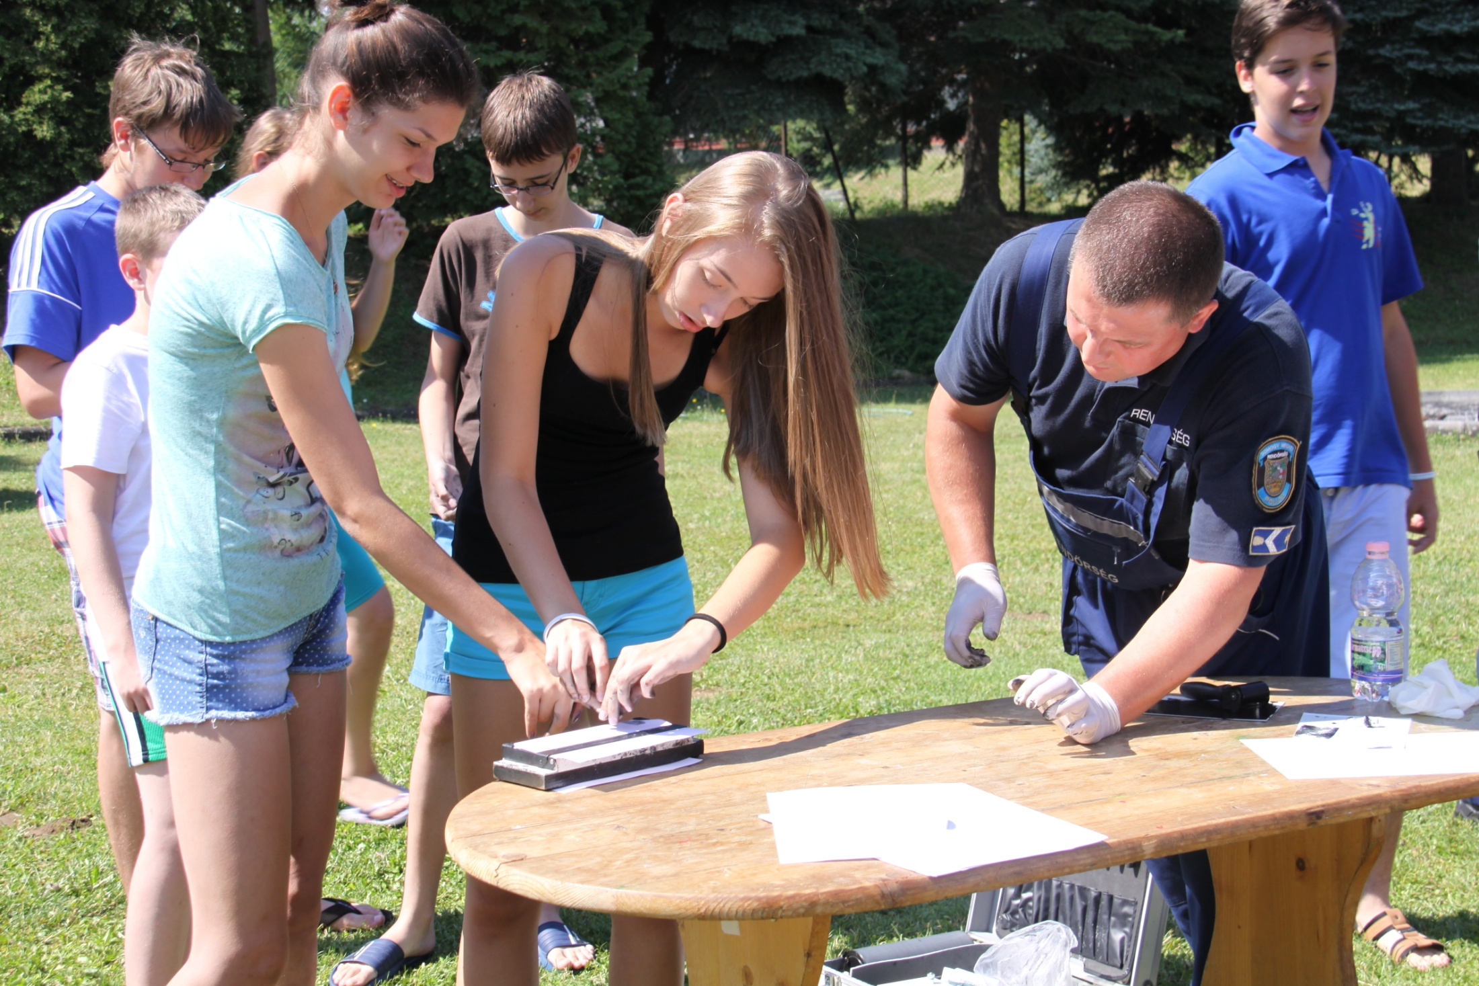

Slide 4
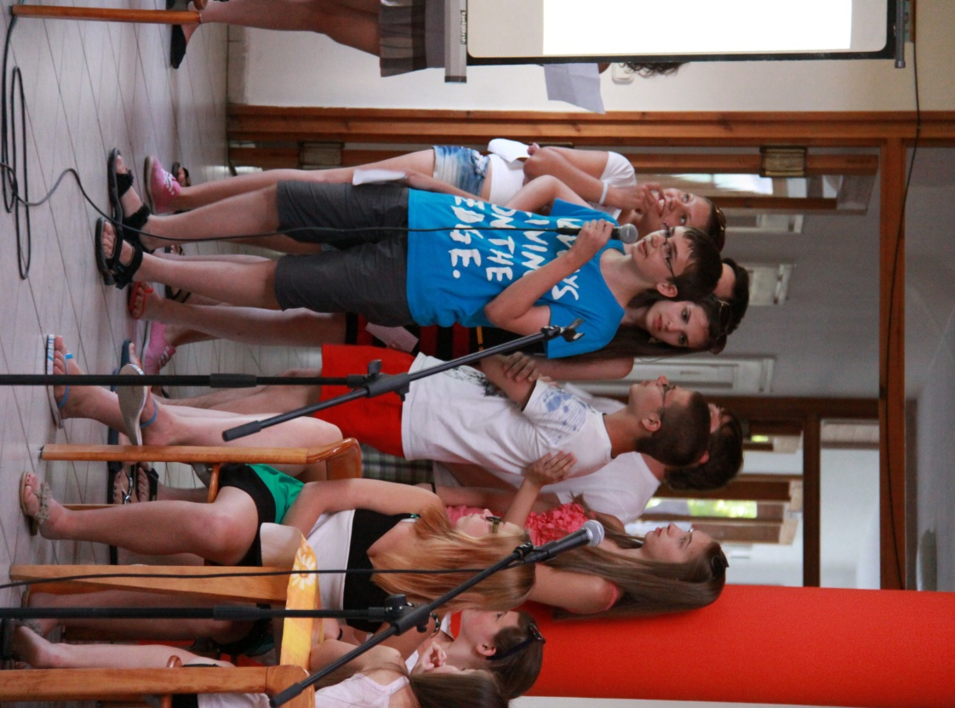
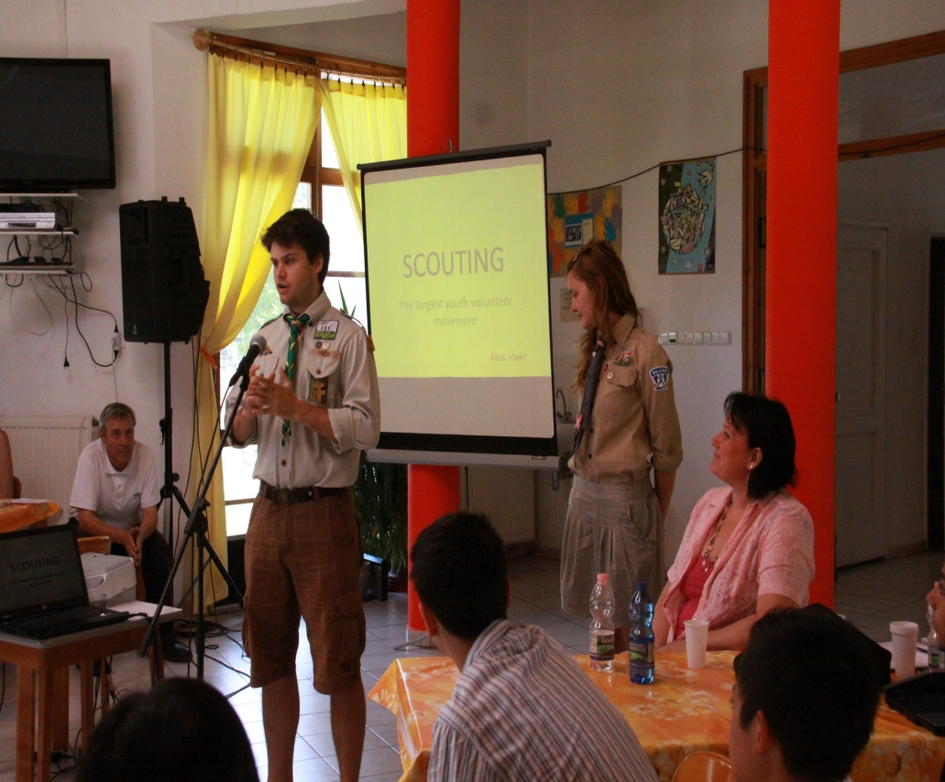
volunteering

Slide 5
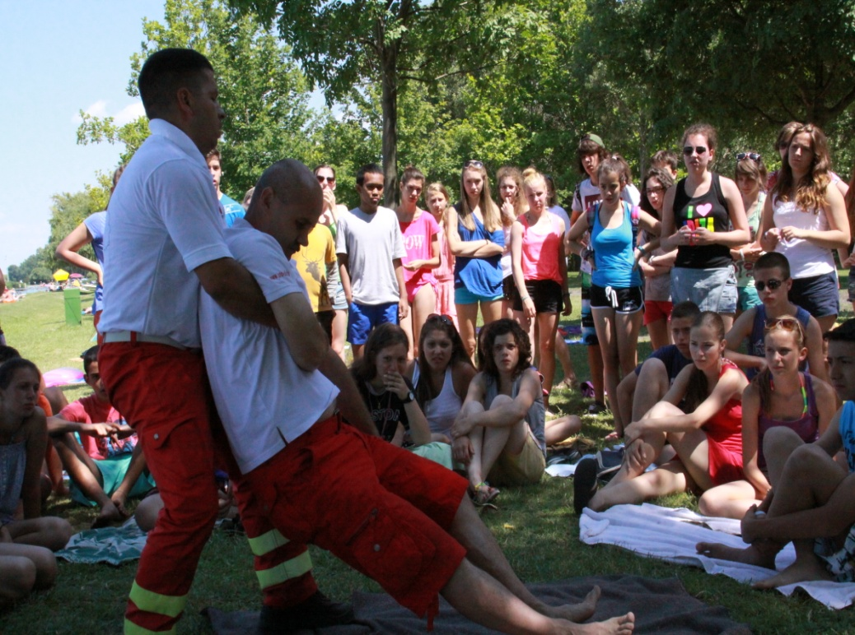
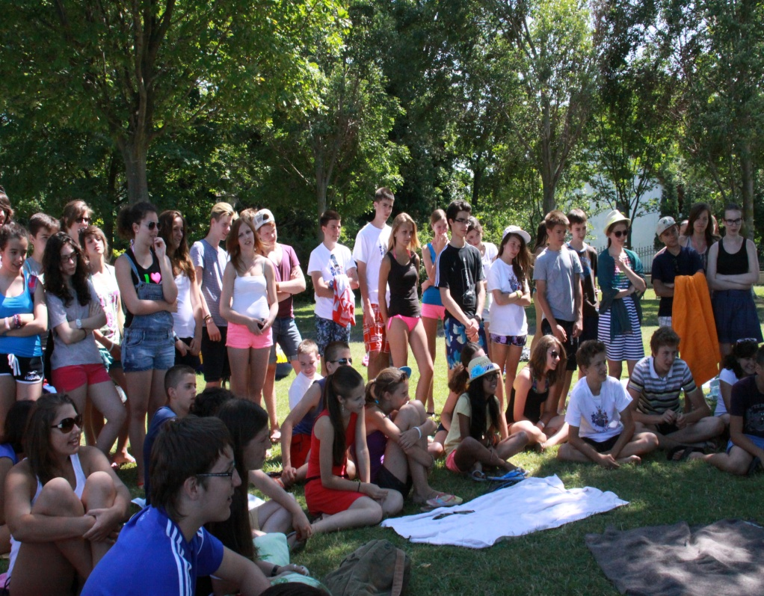
First aid

Slide 6
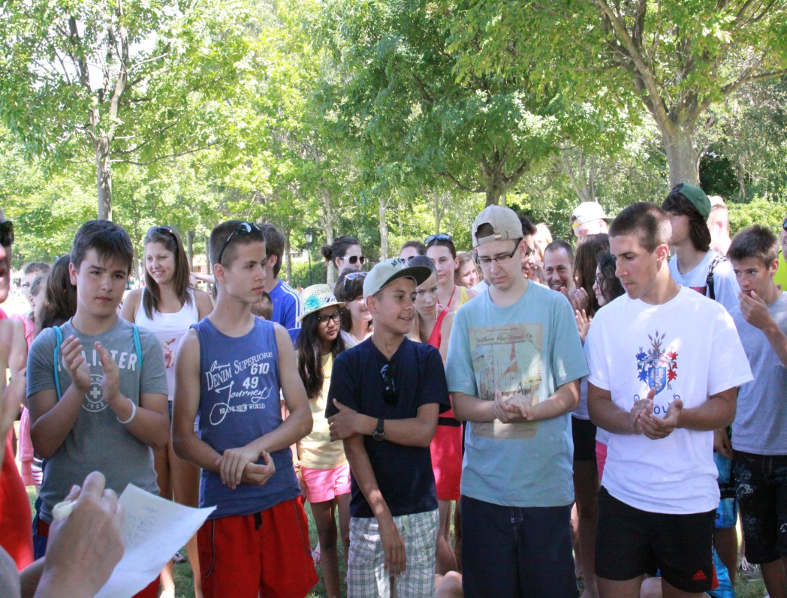
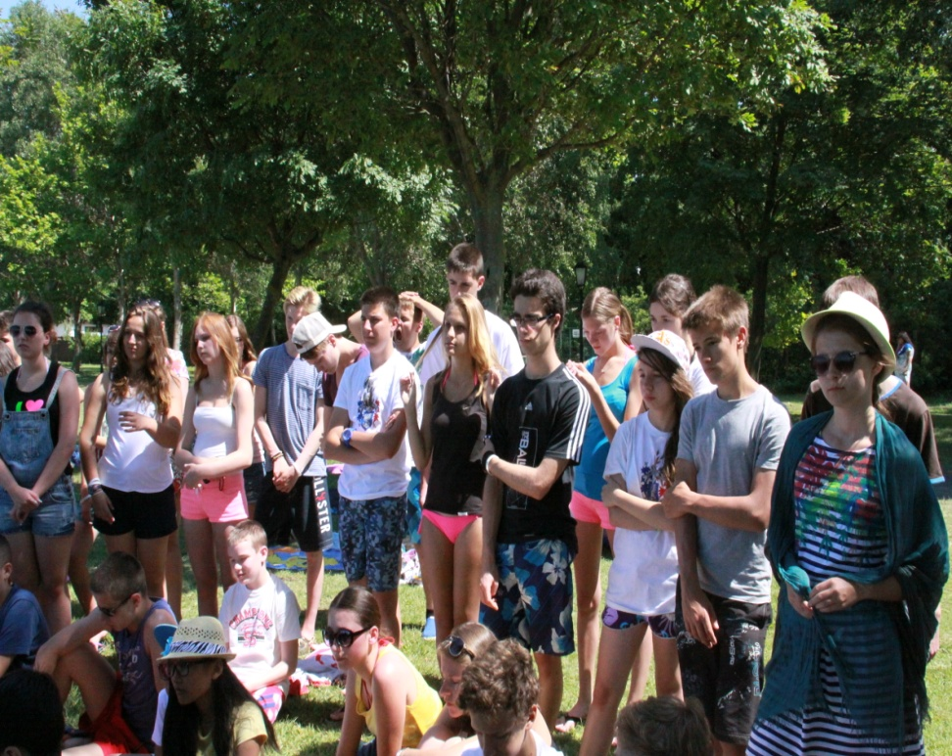
Listen to the presentations carefully

Slide 7
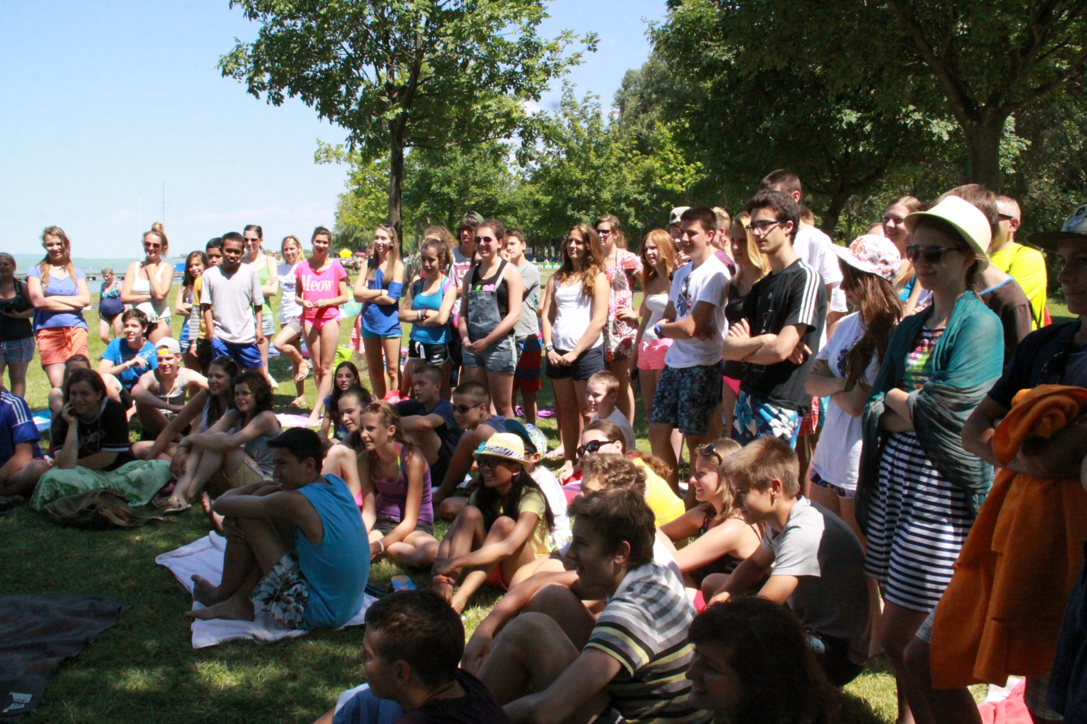

Slide 8
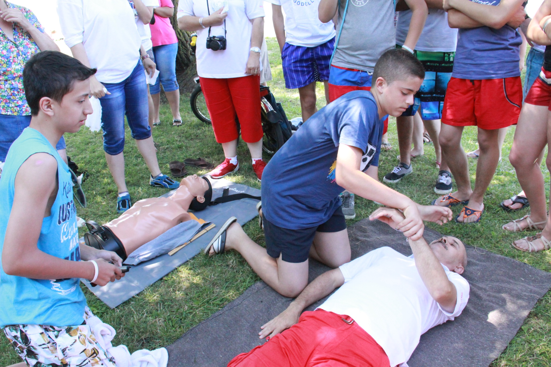

Slide 9
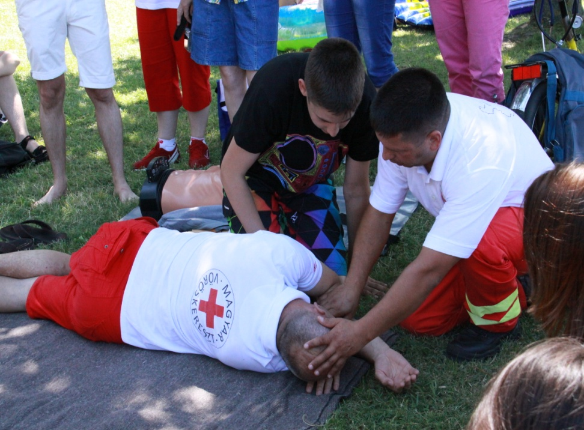
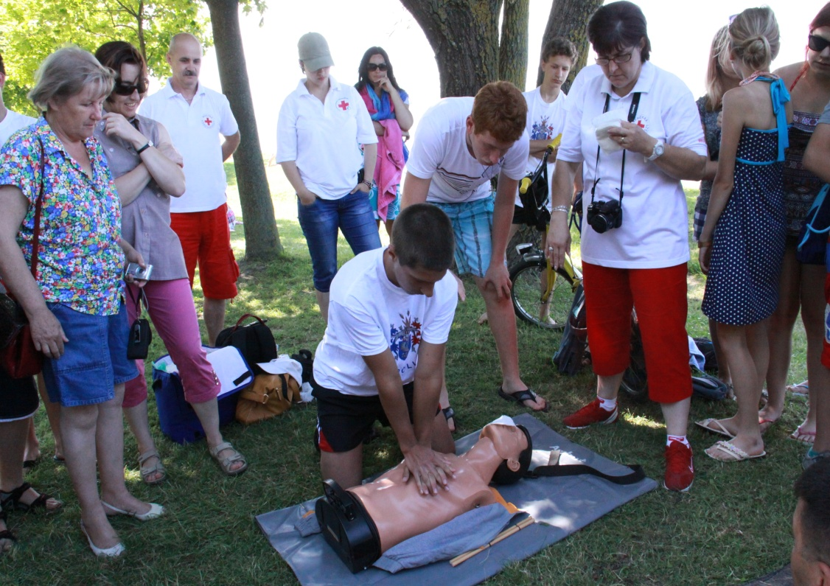
Situation practice

Slide 10
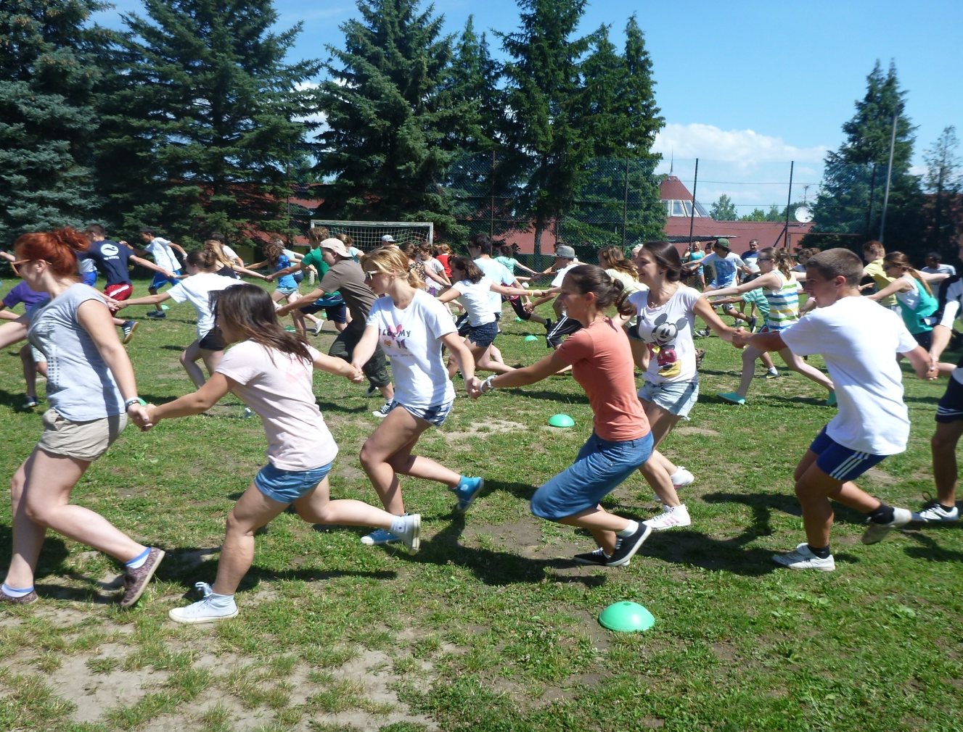
Joint us
Sport activity
Joint us
To solve it together

Slide 11
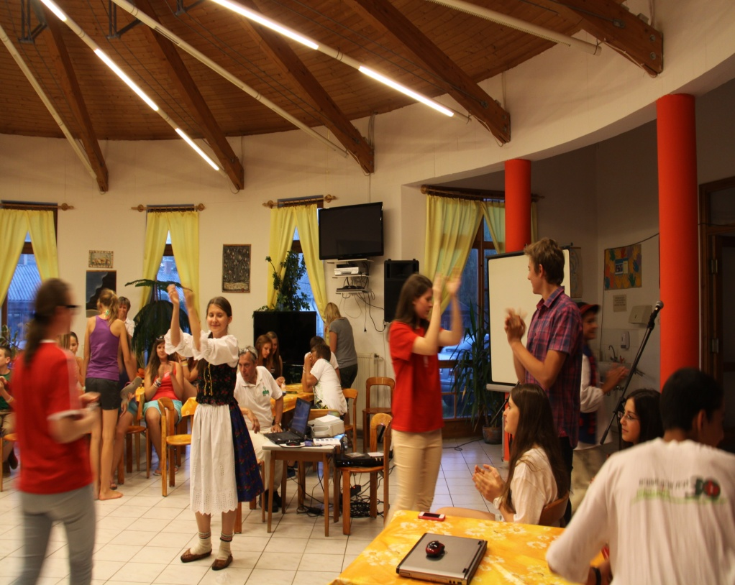
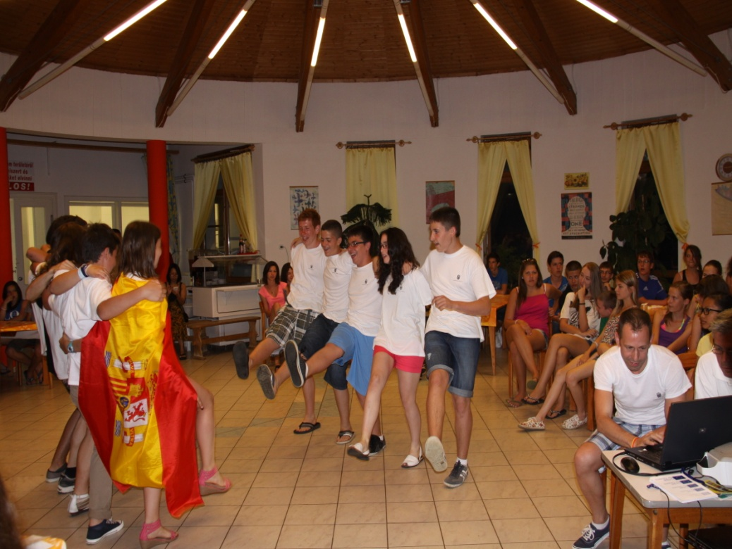
Cities introductions

Slide 12
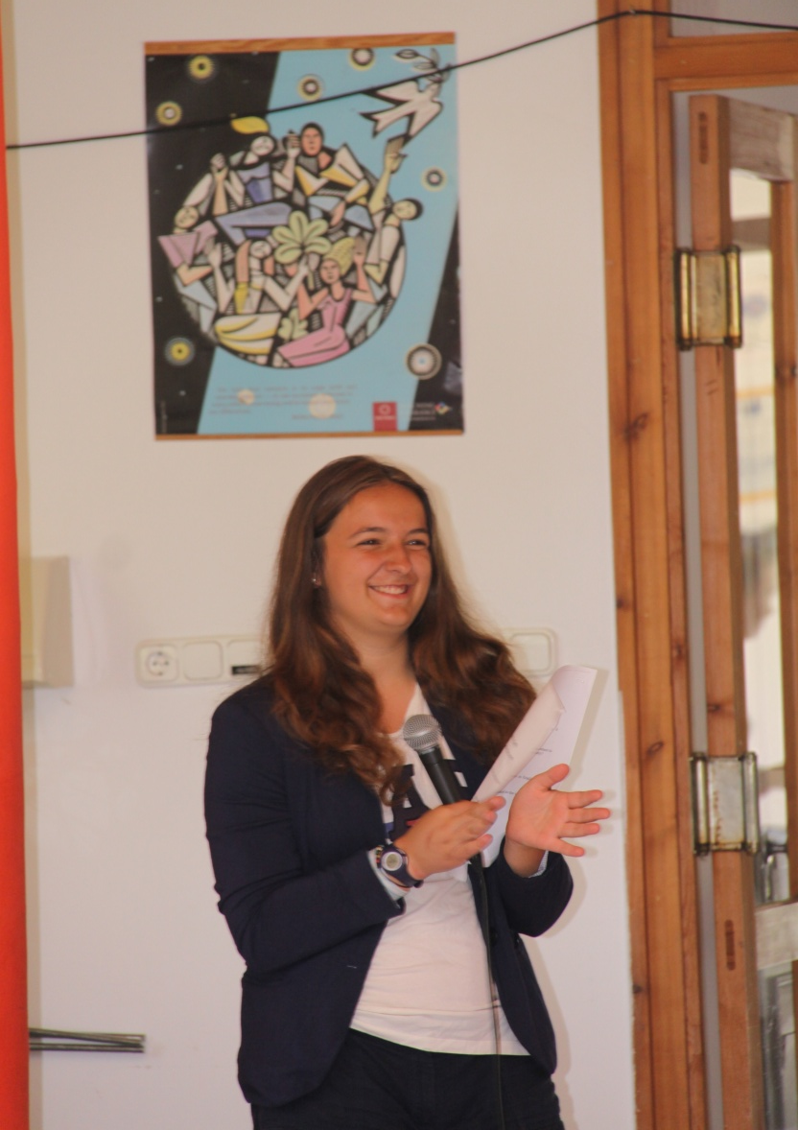
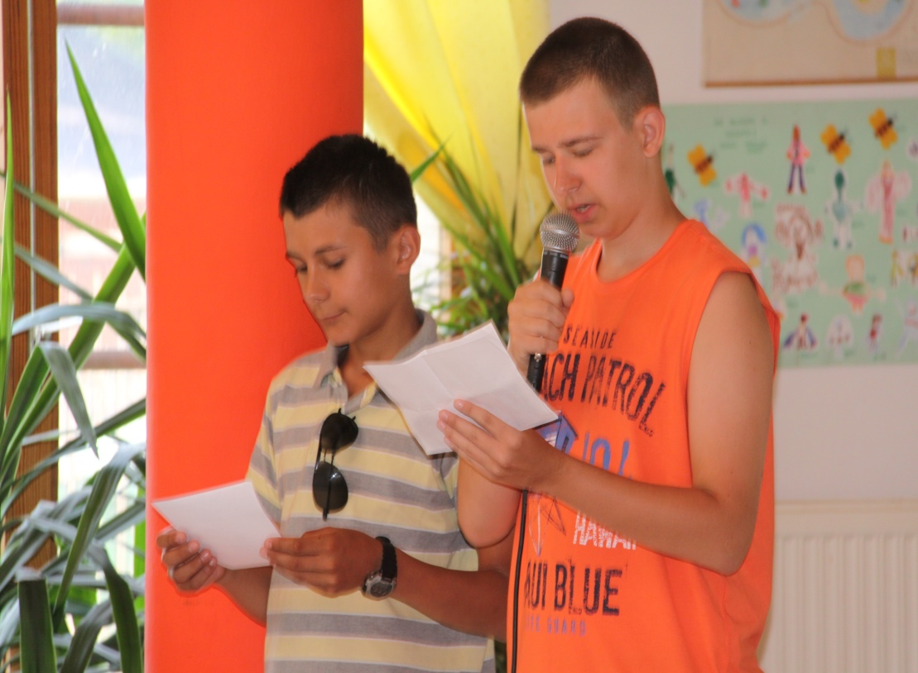
Plenary session of the Committee of the Regions

Slide 13
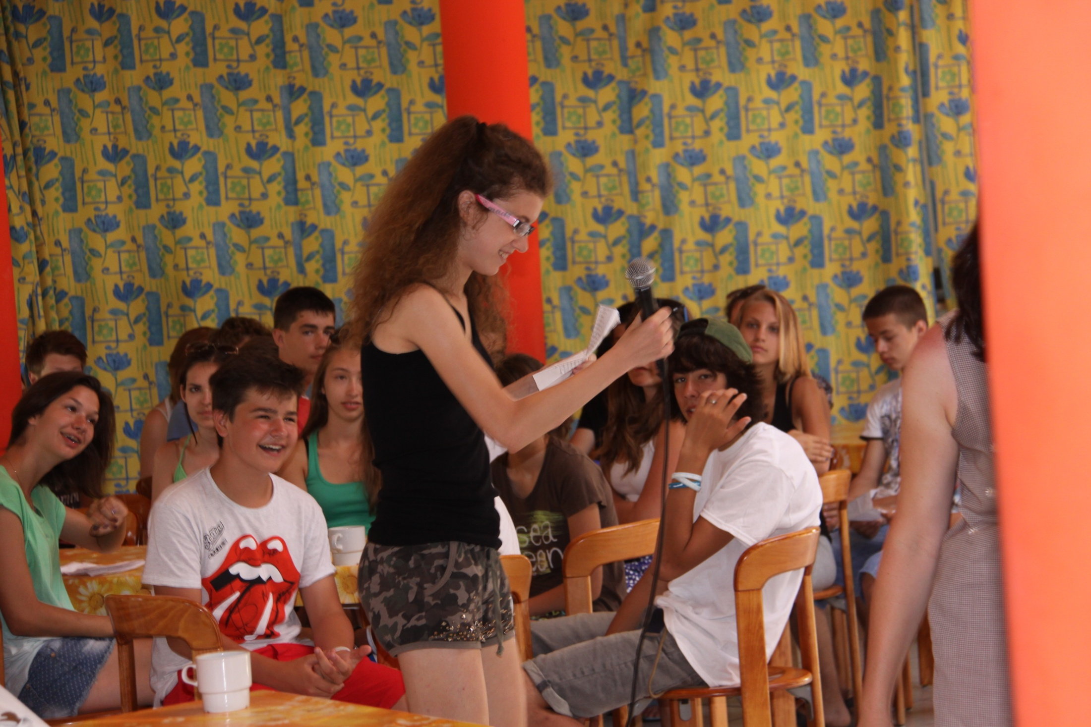

Slide 14
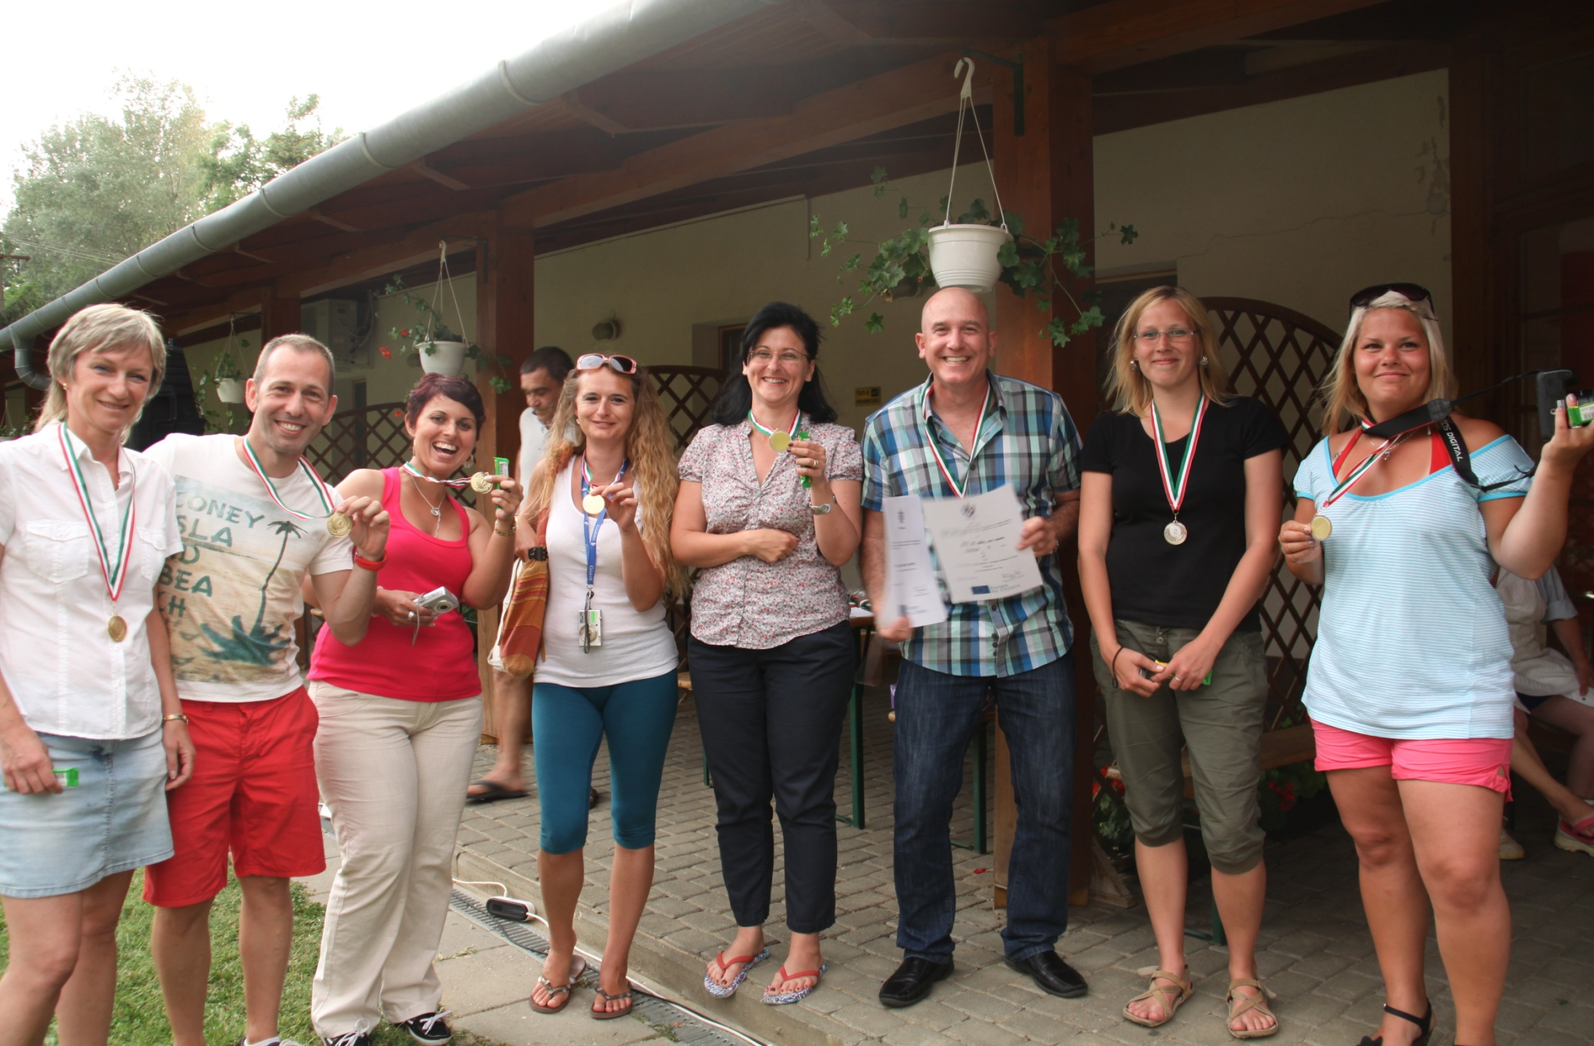

Slide 15
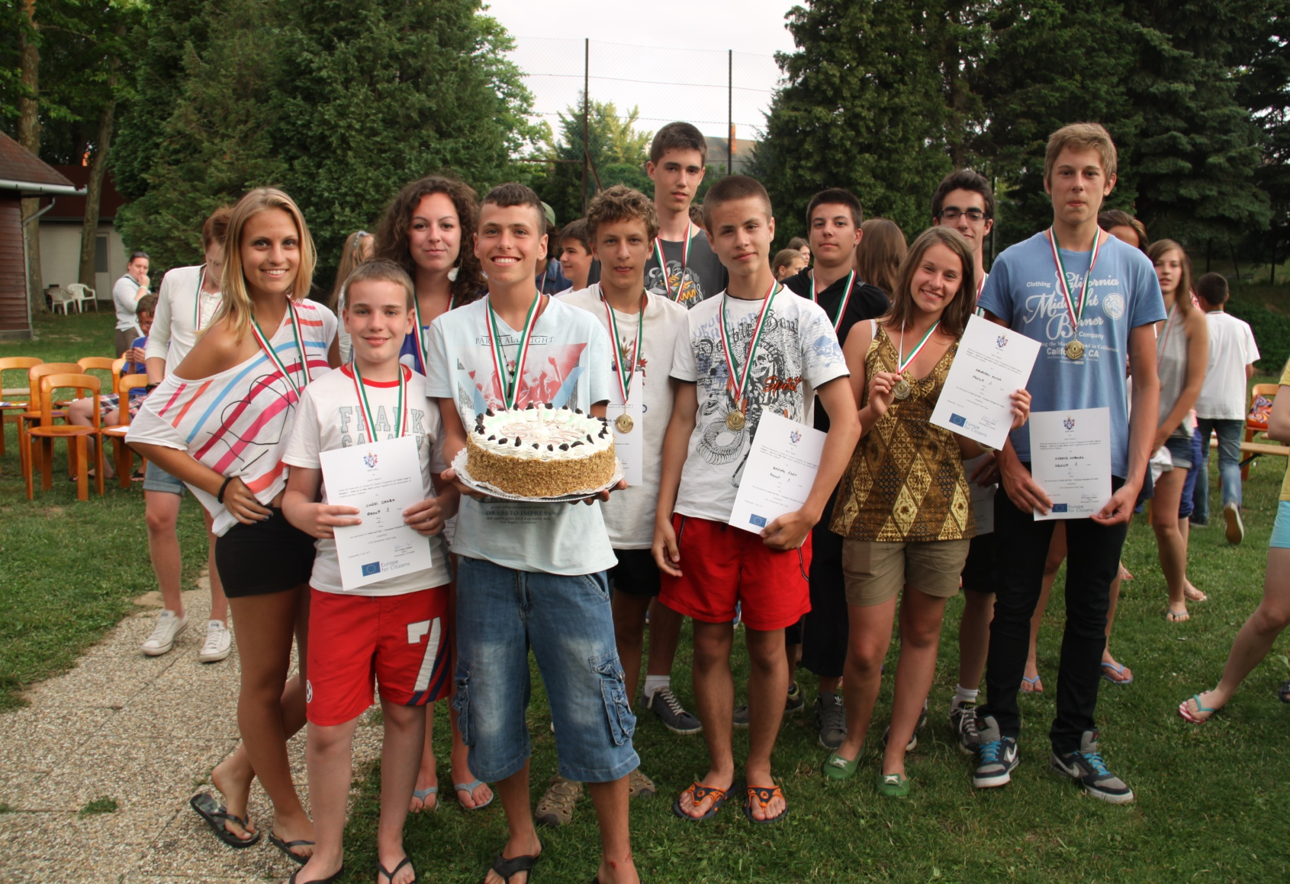

Slide 16
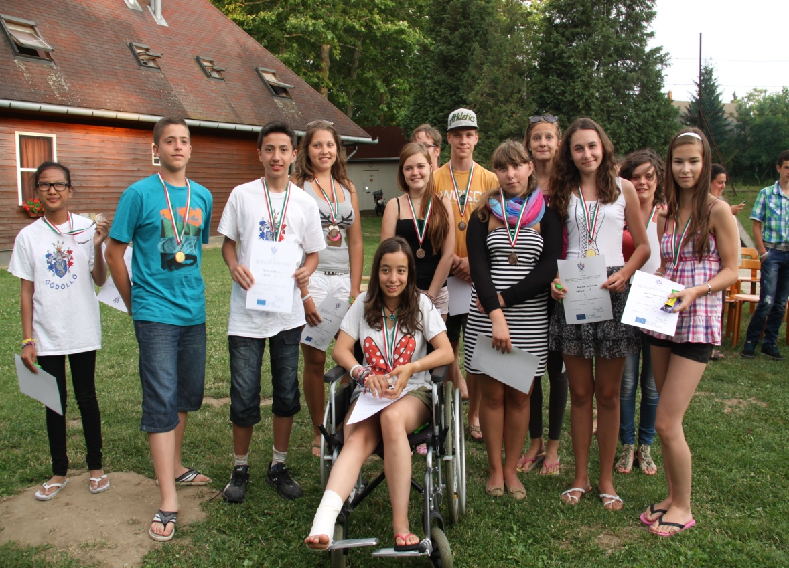
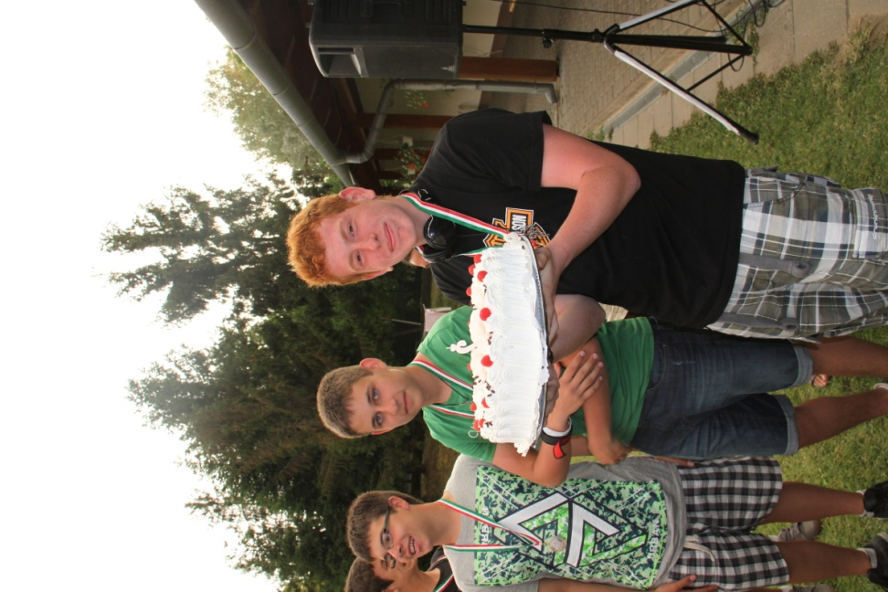
Mixed groups

Slide 17
Results
Many new information to learn about volunteering issue
Knowledge and feel the importance of volunteer activity
Participants surpass themselves - they told
Thinking to solve the problems in team
Network issue to know and help each other
Learn the way to reach compromise
Participants became much more open for volunteer activities by interactive dialogue and situation games on volunteering

Slide 18
Feedback…
„Anyway, I have to say thank you to you because you made of our stay there awsome and one of the best experiences in my life. All of you were excellent and you taught us very important values that we never forget as the volunteer work. And also you made my presidence a really great experience, I looked as a TV presentor but I loved it ;). I really hope I could come back to the camp and see all again. „
Lots of kisses and hugs for you.
Paula :D

